Slide 1
Virtual Address Space & Physical Storage
A virtual address space (VAS) or address space is the set of ranges of virtual addresses that an operating system makes available to a process.
Physical storage and the virtual address space of each process are organized into pages, units of memory, whose size depends on the host computer. For example, on x86 computers the host page size is 4 kilobytes.

Slide 2
Working Set
It is a conceptual model proposed by Peter Denning to prevent thrashing.
The set of pages that a process is currently using is called its working set.
If the sum of all working sets of all runnable threads exceeds the size of memory, then stop running some of the threads for a while.
Divide processes into two groups: active and inactive.

Slide 3
Page Set
The pages of a process's virtual address space can be in one of the following states.
Free
Reserved
Committed

Slide 4
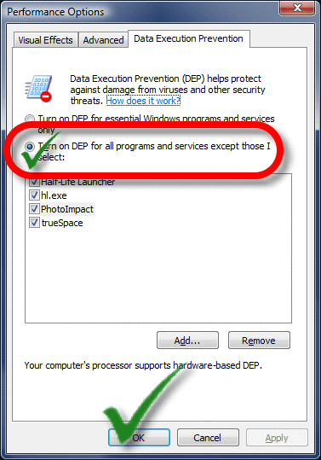
Data Execution Prevention
Data Execution Prevention (DEP) is a system-level memory protection feature that is built into the operating system starting with Windows XP and Windows Server 2003.
DEP enables the system to mark one
or more pages of memory as non-executable.

Slide 5
Memory Protection
Memory that belongs to a process is implicitly protected by its private virtual address space.
In addition, Windows provides memory protection by using the virtual memory hardware.

Slide 6
Memory limits for Windows
Limits on memory and address space vary by platform, operating system, and by whether the IMAGE_FILE_LARGE_ADDRESS_AWARE value of the LOADED_IMAGE structure and 4-gigabyte tuning (4GT) are in use. IMAGE_FILE_LARGE_ADDRESS_AWARE is set or cleared by using the /LARGEADDRESSAWARE linker option.
Limits on physical memory for 32-bit platforms also depend on the Physical Address Extension (PAE), which allows 32-bit Windows systems to use more than 4 GB of physical memory.

Slide 7
Virtual Address space 64 bits

Slide 8
Paging
In computer operating systems, paging is a memory management scheme by which a computer stores and retrieves data from secondary storage for use in main memory.
In this scheme, the operating system retrieves data from secondary storage in same-size blocks called pages (size is power of 2, between 512 bytes and 8192 bytes). The size of the process is measured in the number of pages.
Similarly, main memory is divided into small fixed-sized blocks of (physical) memory called frames and the size of a frame is kept the same as that of a page to have optimum utilization of the main memory and to avoid external fragmentation.

Slide 9
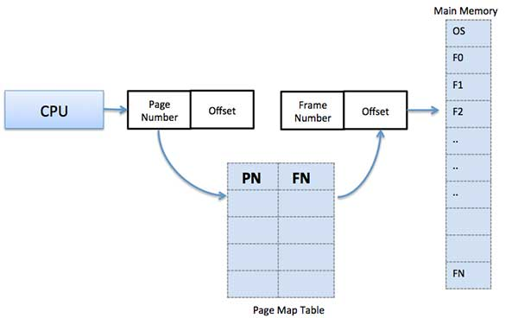
Page Map Table

Slide 10
Types of Paging

Slide 11
Thrashing
What happens if memory gets overcommitted?
Suppose the pages being actively used by the current threads don't all fit in physical memory.
Each page fault causes one of the active pages to be moved to disk, so another page fault will occur soon.
The system will spend all its time reading and writing pages, and won't get much work done.
This situation is called thrashing; it was a serious problem in early demand paging systems.

Slide 12
Fragmentation
As processes are loaded and removed from memory, the free memory space is broken into little pieces. It happens after sometimes that processes cannot be allocated to memory blocks considering their small size and memory blocks remains unused. This problem is known as Fragmentation.
Fragmentation is of two types:
External Fragmentation: Total memory space is enough to satisfy a request or to reside a process in it, but it is not contiguous, so it cannot be used.
Internal Fragmentation: Memory block assigned to process is bigger. Some portion of memory is left unused, as it cannot be used by another process.

Slide 13
Memory Pools
In system, all main storage can be divided into logical allocations called memory pools.
All memory pools in a system are either private or shared.
There are private memory pools, shared memory pools, special shared memory pools, and general shared pool.
As many as 64 memory pools, in any combination of private and shared pools, can be active at the same time.

Slide 14
Virtual Memory
A computer can address more memory than the amount physically installed on the system. This extra memory is actually called virtual memory and it is a section of a hard disk that's set up to emulate the computer's RAM.
The main visible advantage of this scheme is that programs can be larger than physical memory. Virtual memory serves two purposes:
It allows us to extend the use of physical memory by using disk.
It allows us to have memory protection, because each virtual address is translated to a physical address.

Slide 15
Virtual Memory Functions
The virtual memory functions enable a process to manipulate or determine the status of pages in its virtual address space. They can perform the some operations.
Types of virtual memory are:
Paged Virtual Memory
Segmented Virtual Memory

